Slide 1
Lifelong Bonus
Delivered By Jevon Wang

Slide 2
Global
IS IT A
Predefined Frame?
Local

Slide 3
I dislike those who lack experience!
This is Warma opportunities and well-beings

Slide 4
An equipment to enhance your happiness
Windows Defender
Features:
1. abundant social experience
2. ability of critical thinking
Subscribe Now

Slide 5
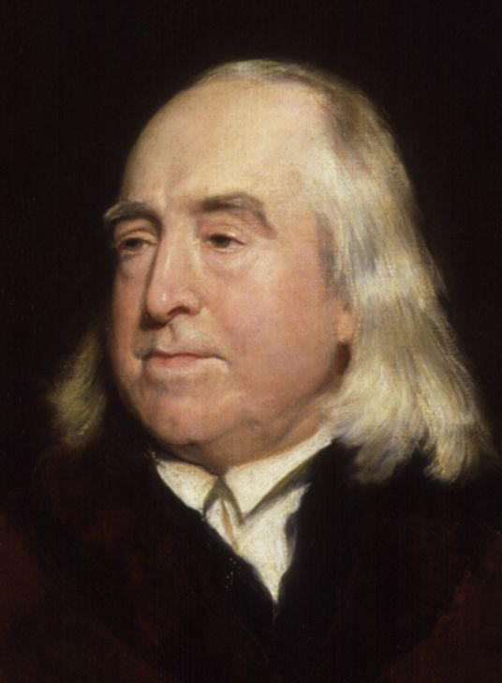
Jeremy Bentham
1748 — 1832
Founder of Utilitarianism
Happiness is the greatest God.

Slide 6
Specific
Outside
self satisfaction
Abstract
Inside

Slide 7
V.S.
shortage of positions
overflow of population
1
1
wealthy knowledge
deep thoughts
1
1
strong DIY abilities
flexible mind

Slide 8
Involution
内 卷
你不要过来呀
社 会

Slide 9
meditation
reality
stable
changeable
Specific
subjectivity
Outside
self satisfaction
Abstract
Inside

Slide 10
Common Source
Practice
which is also examined by practice itself

Slide 11
To teach someone how to fish
is better than to just give him a fish.

Slide 12
I am a little hungry. But let me play one more PVZ...
Brain. Brain. Let me taste your brain! I've been starved for 100, 000 years!

Slide 13
To
Explore
The World

Slide 14
The promotion of oneself is a lifelong bonus for one, and the promotion of the world is a promising vision for all.

Slide 15
References
[1]
Whitelaw J. Collage Praxis: What Collage Can Teach Us about Teaching and Knowledge Generation[J]. Journal of Language and Literacy Education, 2021, 17(1): n1.
特别鸣谢
Thanks For Listening
[2]
云归迟 NKID00
Brunon‐Ernst A. The Felicific Calculus: Jeremy Bentham’s Definition of Happiness[J]. C. Coron C., Dalingwater L.(eds.), Welfare, 2017: 21-36.
[3]
Jonathan Wolff, An Introduction to Moral Philosophy[M], 李鹏程, 译. 北京: 中信出版社, 2019.

